Slide 1
Broken CAPTCHAs and Fractured Equity
Steven Presser
Slides with image descriptions and notes:
pressers.name/enigma2022
Notes:
Would you believe me if I told you that 15% of the internet is behind a CAPTCHA that can’t tell a bot from a human? And what on earth does accessibility have to do with security?
The rest of this talk should start to answer those questions.

Slide 2
Agenda
Background
Assistive Technology
CAPTCHAs
hCaptcha
The Future
Notes:
So here’s our roadmap. I’m going to start with background, mostly on assistive technology and captchas. Next, I’ll talk about hCaptcha itself, and finish with a look at the future.

Slide 3
Assistive Technology
Notes:
As you can probably guess from the talk title, disability and assistive technology is going to play a large part in this. So, for those who aren’t already familiar with AT, let’s begin by looking at some. The use of assistive technologies is really common. Many of us are already using an assistive technology right now – eyeglasses and contact lenses. However, as useful as they are, they don’t have a bearing on how we interact with a computer, so I want to focus on some digital input and output devices.

Slide 4
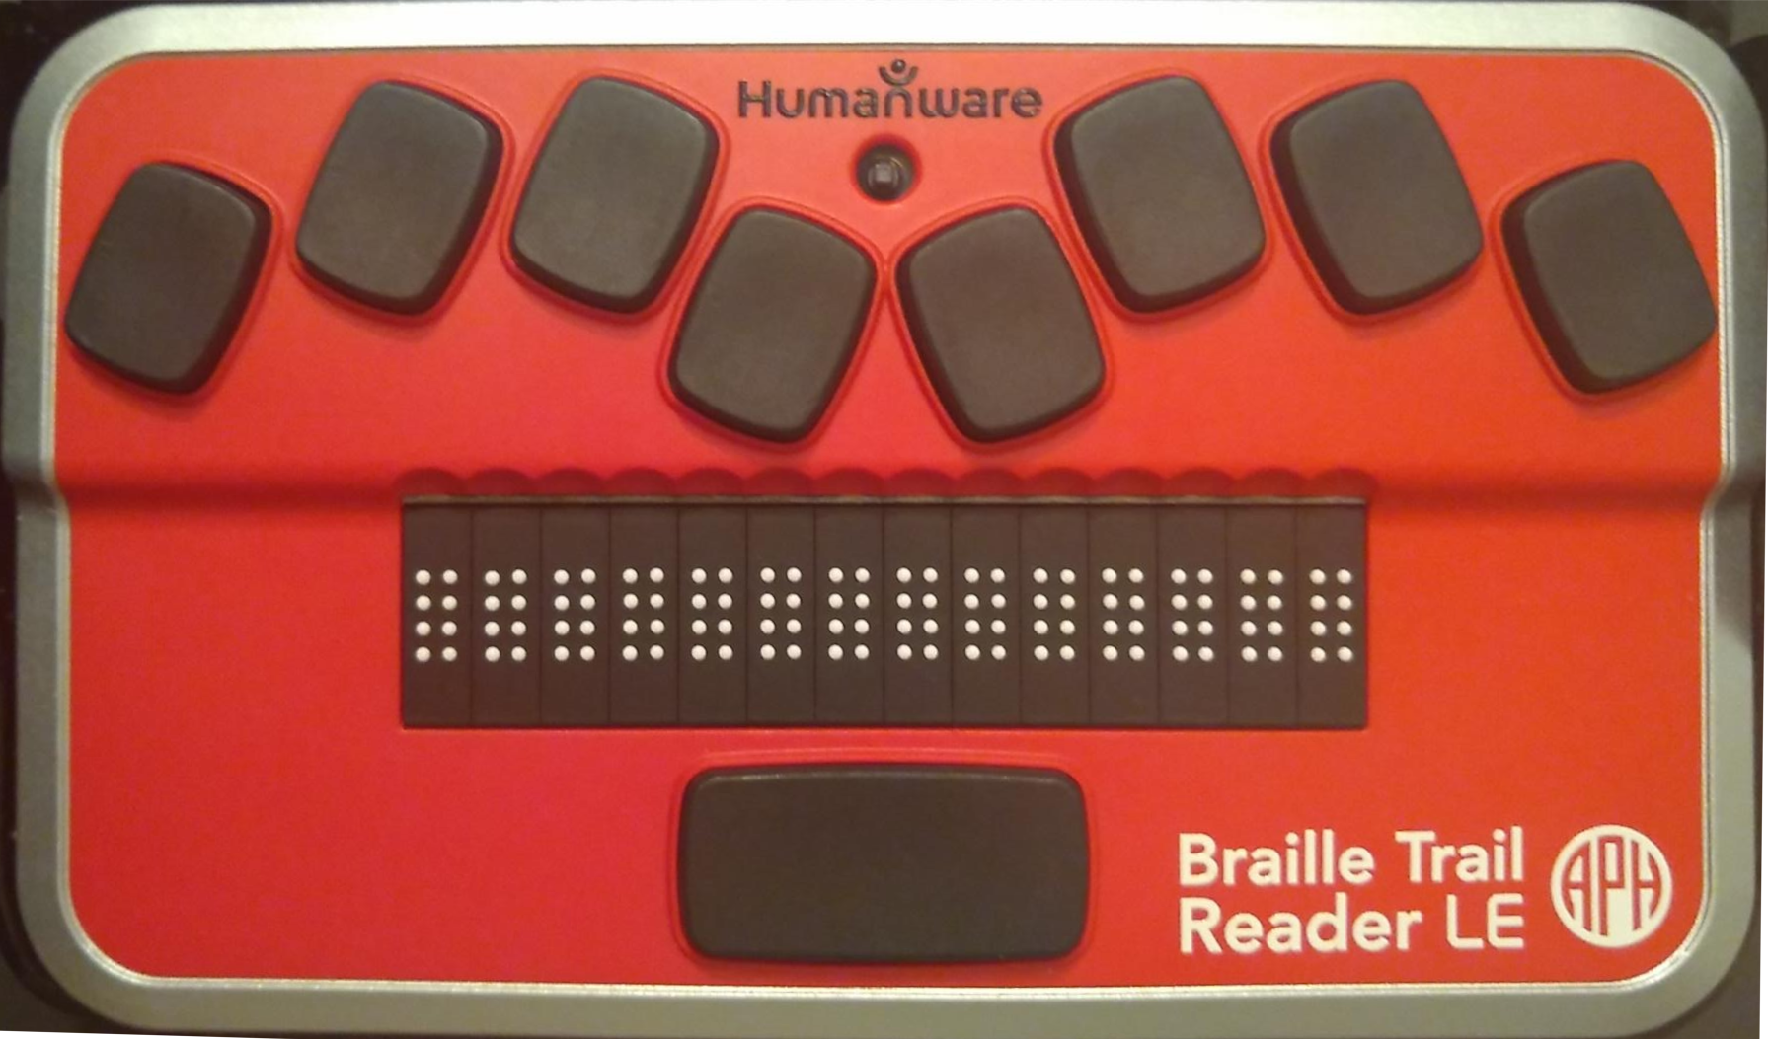
Notes:
Let’s start with this – a refreshable braille display with a built in keyboard. This could be used by someone who is blind or visually impaired instead of or in addition to a keyboard and monitor. The paddles at the top are braille input, while the white dots along the bottom are for reading text.

Slide 5
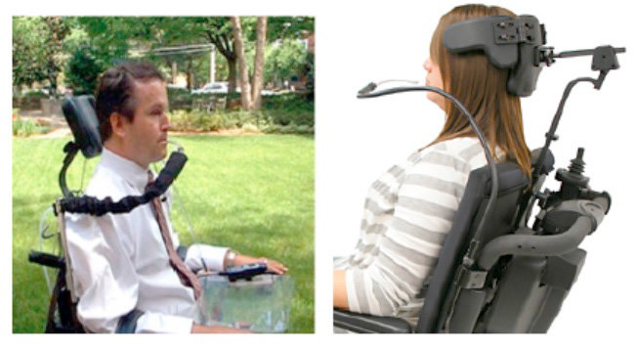
Notes:
Next up, a puff-and-sip is used by someone who typically is quadrapalegic and has no fine motor control. It can be used to replace a keyboard and mouse.

Slide 6
There is no content on this slide
Notes:
Next up, a screenreader. which is software used by people who are print-disabled (typically blind, visually impaired or severely dyslexic). It outputs on-screen text as speech and allows users to navigate with just the keyboard, if they choose to do so.
Before we go any further, I want to show you just how different using an assistive technology can be. I’m about to play for you a recording of someone using a screen reader. I’ll first play it without video, then with the video.

Slide 7
Notes:
Here’s what using NVDA is like – first without the video.
This slide shows a recording of a screen reader user. This recording displays no video, but a version of this video later in the talk will. Transcript of video audio follows.
google dash google chrome google document
search landmark
search combobox has autocomplete
editable search blank
hcaptcha
accessibility
[beep] hcaptcha accessibility dash google search document
heading level one accessibility links
link skip to main content
main landmark clickable accessibility dash hcaptcha heading level three https colon slash slash www dot hcaptcha dot com ac-
document busy blank

Slide 8
There is no content on this slide
Notes:
Before I play it with the video – anyone think they know what the user was doing there? Show of hands.

Slide 9
Notes:
Show of hands – of those of you who thought you knew what the user was doing, how many were right?
I want to emphasize that I have shown only a very small selection of the assistive technology available and many more options exist. These alternative methods have various advantages and disadvantages. For example, a screen reader is very hard to use to skim text, but typing input is fast. In contrast a puff-and-sip may allow someone to skim quickly, but might be very slow to type.
Assistive technology is really tuned to a disability and to a person, so it is as variable as disability. Which is to say – extremely. Two people with the same disability may use entirely different AT because that’s just what works for them.
This slide shows a recording of a screen reader user using google to search for "hcaptcha accessibility" and then selecting the first result, the hcaptcha help page on accessibility. Transcript and description follow, description items are prefixed with "description:" while audio transcript is prefixed with "audio:".
audio: google dash google chrome google document
description: the google.com homepage is seen. A blue box surrounds the search box.
audio: search landmark
audio: search combobox has autocomplete
audio: editable search blank
description: the user types "hcaptcha" and that text appears in the search box. Autocomplete options appear below the box.
audio: hcaptcha
description: the user types "accessibility" and that text appears in the search box. Autocomplete options appear below the box.
audio: accessibility
description: the visible page changes to the google search results page. A dashed blue box surrounds where the search box previously was. The top result is the hCaptcha accessibility page, then a ox that reads, "people also ask"
audio: [beep] hcaptcha accessibility dash google search document
audio: heading level one accessibility links
description: a small yellow and slightly larger red box appear in the upper left-hand corner of the page. A small box that reads "skip to main content" briefly appears, then disappears.
audio: link skip to main content
description: a blue box appears around the title of the first result. The title reads "Accessibility - hCaptcha". A small yellow box appears above that, where the URL of the result is shown.
audio: main landmark clickable accessibility dash hcaptcha heading level three https colon slash slash www dot hcaptcha dot com ac-
description: all the colored boxes disappear and the browser begins to load the page.
audio: document busy blank
description: the hCaptcha help page on the topic of accessibility appears.

Slide 10
CAPTCHAs
Notes:
Next up are captchas.
CAPTCHAs are small puzzles that are simple for humans to solve and hard for computers (AI-hard, human-easy). They’re used to ensure that a request comes from a human, and not automation (or a bot)
Please bear with me for a little history ---
Name is from “CAPTCHA: Using Hard AI problems for Security”, published in 2003, which ...

Slide 11
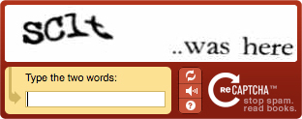
Notes:
... lead to reCAPTCHA – the first version of which you see here. Other things were CAPTCHAs first, just.. not quite called that.
ReCAPTCHA was one of the first, if not the first, to make CAPTCHAs do useful work. It got humans to label hard-to-read portions of text to train optical character recognition systems
What was brilliant about reCAPTCHA was how it aligned diverse problems – in this case, websites and users wanted to eliminate automation and authors of OCR software needed better data. ReCaptcha positioned these groups to solve each other’s problems in a mutually beneficial way.

Slide 12
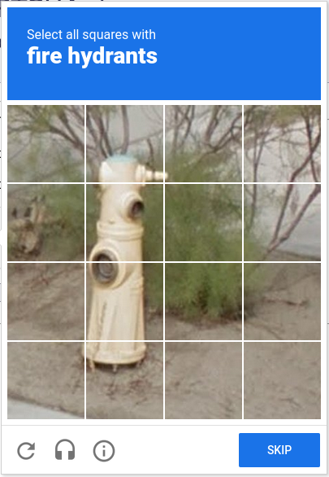
Notes:
ReCAPTCHA was bought by Google, who wanted better OCR. Eventually, however, machine OCR got to be as good or better than human, so that was no longer an AI-hard problem.
So next google looked around for another AI-hard problem, and seems to have settled on object identification in street photography, probably for their self-driving cars.

Slide 13
Notes:
And then they revised reCAPTCHA once again - into the now-familiar “I’m not a robot” checkbox. This tracks the user’s behavior on the page and applies machine learning to determine if the user is human or automation. The user is asked to solve a puzzle only if they look like automation.
Again, reCAPTCHA isn’t the only CAPTCHA out there, but it is the best known and has tended to be at the cutting edge of CAPTCHAs.

Slide 14
hCaptcha
Notes:
And that brings us – finally – to hCaptcha. hCaptcha is a commercial product, put out by a company called Intution Machines, Inc (IMI) and used to prevent automation on about 15% of the internet. Mostly through their largest customer, Cloudflare, who picked them up in April 2020 (which is how I heard about them)
Intuition machines is a blockchain-based data labeling service company. That means is a researcher has a large set of pictures of say.. modes of transport… and wants to have them get labeled with what type of transport is in each picture, they can pay IMI to get labels attached to each picture, IMI croudsources this via hCaptcha, and website owners get paid for running hCaptcha. And somehow a blockchain is used

Slide 15
hCaptcha is...
Private
Secure
Faster/lower friction
Notes:
Intuition Machines claims on their homepage that hCaptcha is 3 things: Private, as in they don’t track or sell your data. Secure, as in keeps out automation and makes sure the user is human, and faster/lower friction – as in easy for users.

Slide 16
Notes:
So how does using hCaptcha work?
Let’s start by walking through their visual, timed workflow. You start by filling out a form and then checking the box labeled “I am human”. At this point, the software looks at ~criteria~ and decides if it believes you might be a bot. These criteria are an IMI secret, but might be things like IP address, if it has put cookies in your browser before, and behavior on the page. If you look odd, you get shown a challenge.
Guess who is most likely to look odd? Users of assistive technology, who might do things like navigate a page and never move the mouse.
My personal experience – across their site, ebay, Cloudflare, and the submission site for this conference, is that it always challenges. After all hCaptcha exists to get data labeled, so they’re incentivized to show as many photos as possible to as many users as possible. Or perhaps something about my profile is just suspicious.

Slide 17
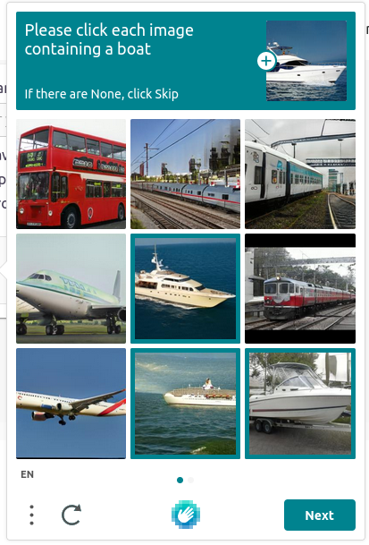
Notes:
Anyway, let’s continue with the visual timed workflow. You would then be presented a challenge like this – select all images that contain a boat. You click them, then click next.

Slide 18
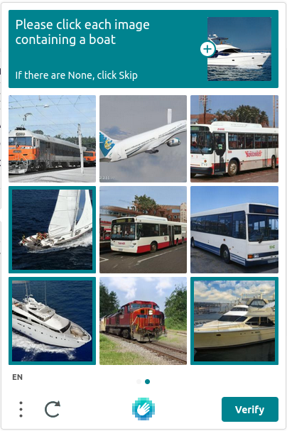
Notes:
Repeat for a new set of images….

Slide 19
Notes:
And finally, the popup goes away, the box checks, you’re certified as human, and on you go.

Slide 20
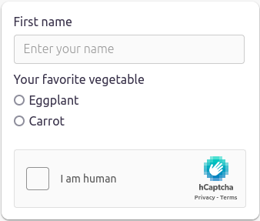
Notes:
So let’s say you can’t use the visual, timed workflow. Perhaps you’re blind and can’t identify images. Or quadrapeligic and can’t select images quickly enough. How do you get through hCaptcha’s challenge?
Well, you use their “accessible workflow”.
So let’s start walking through that. It starts in the same place – with a form to fill out and an “I am human” box to check. So you check that box.

Slide 21
Notes:
And up pops the challenge. Unfortunately you can’t do it. If you’re lucky, you don’t spend time trying and instead look for accessible options.

Slide 22
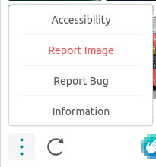
Notes:
Eventually you might find the burger menu in the bottom left corner of the popup. And from there the accessibility menu item. Clicking on that...

Slide 23
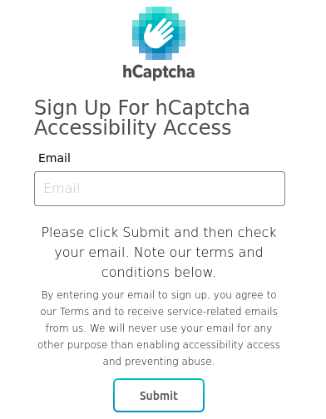
Notes:
Brings you to a page where you can put in your email to sign up for “accessibility access”. Submit that...

Slide 24
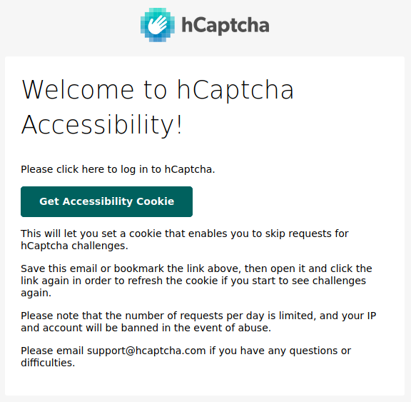
Notes:
So then you go to your email, and eventually this shows up. There’s a link (styled to look like a button) in there that says “Get Accessibility Cookie”, so you click that.

Slide 25
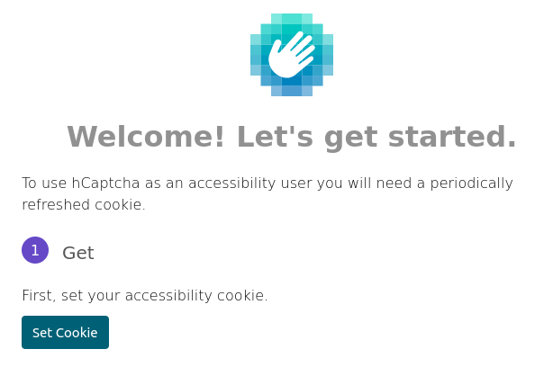
Notes:
Which brings you to a webpage that looks like this. You click “Set cookie”...

Slide 26
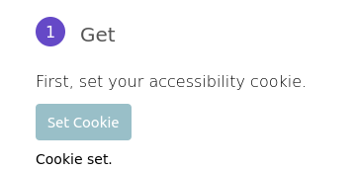
Notes:
And a little notification lets you know that a cookie is set.
By the way, I believe this notification doesn’t alert to screen readers and other alternative output when it appears, so if you use one of those technologies you’re left wondering if it worked correctly. Which... given that that’s a massive portion of the people expected to use this workflow is one hell of a usability failure. A large portion of the intended audience for this workflow isn’t going to get feedback on whether or not it actually worked or not.
Anyway, at last you go back to the form you were working on...

Slide 27
Notes:
Which has inevitably timed out. So you fill it in again and try to check the “I am human box”….

Slide 28
Notes:
Which works! Yay! Seems like a reasonable process, right? At least to cover the whole gamut of potential assistive technology and disabilities that might have trouble with the visual timed workflow.
This process is 7 or 8 steps, assuming everything works properly, some of which involve waiting. The visual, timed workflow is 3 steps. That’s a huge difference, especially in comparison to other captchas, which have accessible challenges that add no extra steps.
I should point out that this is the first-time workflow. It doesn’t always take so long. The cookie is good for 24 hours once set, so you only have to deal with the dashboard once a day. And once you have the hCaptcha email, you can always use that to get back to the dashboard, so some of the signup process is skipped.

Slide 29
hCaptcha is...
Private
Secure
Faster/lower friction … except for people with
disabilities
Notes:
Nonetheless, that’s definitely not a low-friction workflow. So let’s go back to what hCaptcha is and mark that it is faster or lower friction… except for people with disabilities.
But there are two big problems in how this workflow works, compared to the visual, timed workflow.

Slide 30
Privacy
Notes:
Let’s call the first one the privacy problem.

Slide 31
Notes:
This is a screenshot of hCaptcha’s accessibility dashboard – where you sign into with that link they send you. And in the red circle is the email I used to sign up.
This has some pretty significant privacy implications. This means that every cookie hCaptcha hands out via the accessibility workflow, they can tie back to a specific email – effectively to a permanent identity of an individual. And because hCaptcha embeds in many places, they could follow that cookie and therefore that user. With most captchas, you can just wipe cookies if you don’t want them to track you. But not with hCaptcha’s accessibility workflow – each cookie comes pre-tied to a user identity.
I should point out that hCaptcha says they don’t do this in their terms & conditions. But there’s really no way to verify that, and it’s frightening enough they have the technical capability.
In short, in terms of accessibility and privacy, hCaptcha isn’t even separate but equal, it’s separate and unequal. Is this really the world we want to live in? One where certain people, because of things they can’t change, must forefit their privacy to participate in society?

Slide 32
hCaptcha is...
Private … except for people with disabilities
Secure
Faster/lower friction … except for people with
disabilities
Notes:
So let’s go back to what hCaptcha is and update that…
Strike privacy, and say “private except for people with disabilities”.

Slide 33
Security
Notes:
I said there were two problems though. That was privacy. Now lets deal with security.
I’m not the first to look at security, “A low-cost attack against the hCaptcha system” Hossen & Hei, used images as training for machine learning, passed with a 95% success rate. hCaptcha has had time to work on countermeasures, but no reevaluation has been done that I’m aware of.

Slide 34
hCaptcha is...
Private … except for people with disabilities
Secure ... ?
Faster/lower friction … except for people with
disabilities
Notes:
So let’s go back to what hCaptcha is and put a question mark next to security.

Slide 35
When the user clicks a button
When the user enters their email
When the user opens a link in an email
Whenever – check the User-Agent
Notes:
Alright, pop quiz before we go into the second problem. When does the accessible workflow verify the user is human? Show of hands...
Those of you who didn’t answer were the most correct – it doesn’t. No part of the accessible workflow is an AI-hard problem and difficult to automate.

Slide 36
Automation
Notes:
This is a short video of some quick automation I put together to prove this process can be automated. This is nothing fancy – xdotool driving the mouse and a little custom python to run a mail server. And as you can see, it’s perfectly capable of running through the entire accessibility workflow.
hCaptcha has some countermeasures, mostly in the form of rate limiting. Each cookie can only be used so many times. Each account only gets so many cookies per day. Each IP address can only sign up for so many accounts per day. Each domain can only sign up for so many accounts per day. But domains are cheap and rotating IP addresses is easy, so it’s not clear how effective these are in the real world.
Video description: There is no audio in this video. It is a reduced length video demonstrating that software is able to walk through the accessible workflow automatically. The left and center are a browser window, initially at the hCaptcha accessibility signup page. A terminal window is shown on the right.
The video begins with a random email address being input to the signup page. The page then changes to read "Thank you. Please check your email and click the link". Next it changes to display the hcaptcha.com homepage and follows as the focus goes to the hcaptcha widget. At the widget, it checks the "I am Human" checkbox without being challenged. The entire time, the terminal scrolls lots of text about the minute details of the automation. This shows details of what the running code is doing. This starts with it detailing the keystrokes being input to the browser window. As the browser page changes to the thank you message, the terminal prints out the email message with the hCaptcha accessibility link. As the browser page changes to the hCaptcha homepage, the terminal shows keypresses being input again.

Slide 37
hCaptcha is...
Private … except for people with disabilities
Secure … except that it can be automated
Faster/lower friction … except for people with
disabilities
Notes:
And let’s update what hCaptcha is again…
Strike secure, and say “except that it can be automated”

Slide 38
Notes:
So by now I hope I’ve convinced you that hCaptcha’s accessibility workflow is broken. All the work I did on it was under their bug bounty program. I disclosed this to them and to cloudflare (who run a second instance). Both declared it was not an issue due to mitigations that they declined to disclose or due to the resource usage required to circumvent the captcha.

Slide 39
Notes:
However, this is also a great time to note that hCaptcha appears to have shut the automated accessible workflow down sometime in the second half of 2021 or early 2022. Or at least I haven’t been able to do it for a couple months and have disabled all old accounts. It’s all still there, but now the email input throws an error and you have to email support and wait for a human support person to handle your ticket. They’ll ask for your IP, browser, what website you’re on, and what about hCaptcha doesn’t work for you. The last is particularly critical. This doesn’t quite require disclosing a disability, but gets real damn close. Saying “I can’t see the photos” isn’t the same as saying “I’m blind”, but it has the same effect.
The decision use a process where people must prove they deserve to use the accessible workflow completely circumvents that captchas are supposed to be automated tests and significantly impacts the privacy and usability for all users of the accessible workflow.

Slide 40
The Bigger Picture
Notes:
So let’s take a step back and look at the bigger picture

Slide 41
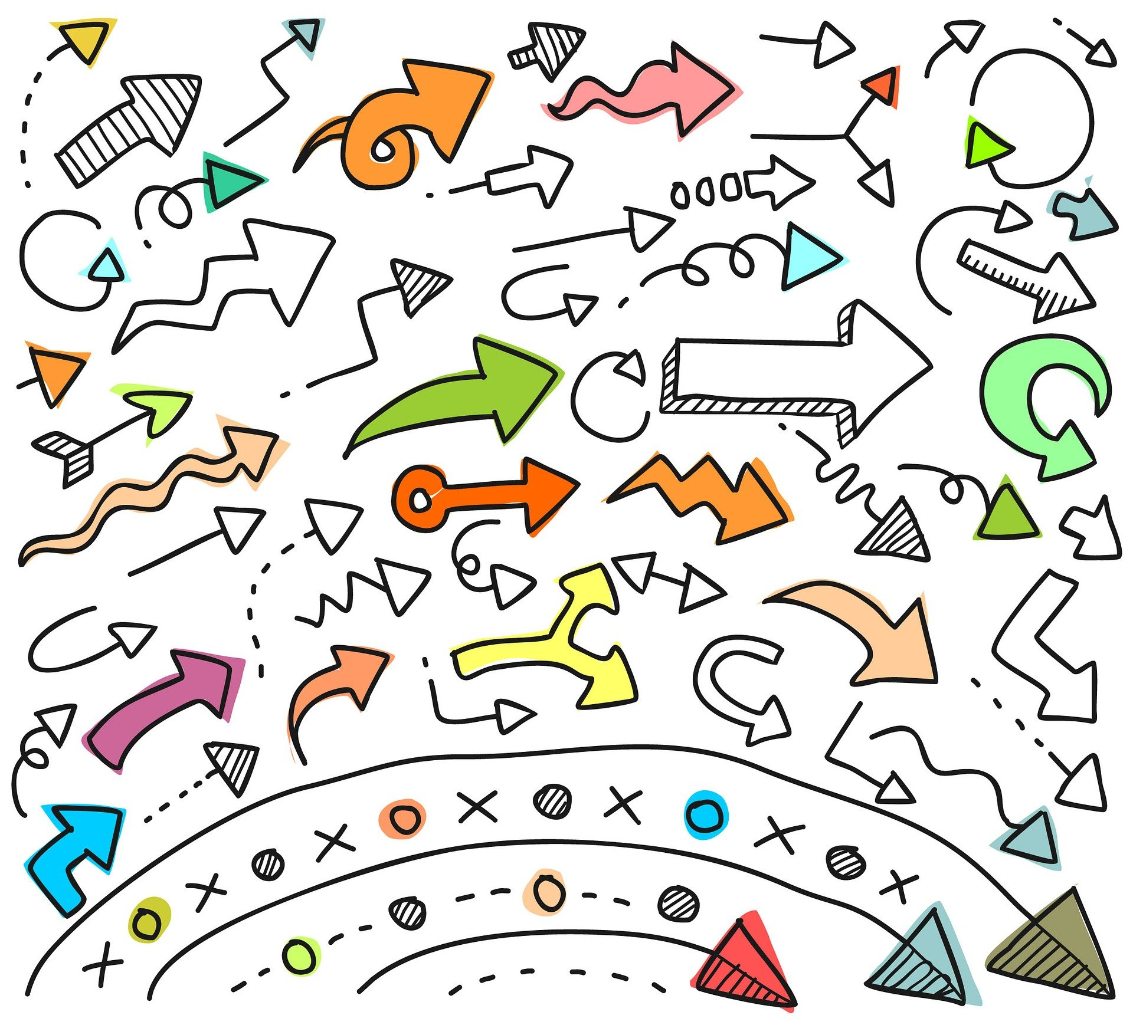
Notes:
Let’s talk about how such a flawed design came to be. Before I get into that, I want to be clear: this is derived from hCaptcha’s public writings, and is my best reconstruction. I have no private information and haven’t spoken with them about their process.
hCaptcha is a data labeling service, so they need data to label. Computers put out (typically) audio and visuals – not much for the other senses. So captchas will be either audio or visual captchas.

Slide 42
🎧
Notes:
Most captcha services provide an alternative audio captcha for those who cannot complete visual captchas. However, hcaptcha believes, and this is a direct quote from their support staff, that “audio options provide virtually no security” and that Google’s reCaptcha disables audio captchas if it believes traffic is suspicious. I have found no evidence that the last part is actually the case, despite many questions across the internet asking how to disable audio captchas.
This belief that audio captchas are low security is, in my opinion, what lead hCaptcha to choose to do a visual-only captcha. After all it’ll be high security!

Slide 43
Notes:
But somewhere along the way, someone realized they need to make this accessible. I don’t know the mechanism – perhaps someone consulted a lawyer, who reminded them that they were at risk of being sued if the product wasn’t accessible to everyone, not just those who currently have good eyesight and fast reflexes. To their credit, it does appear they implemented the accessible workflow at the end of the engineering process, but before launch.
However, discovering the accessibility requirement would have been a good time to step back and reconsider “no audio captchas”. Instead, they came up with the strange “accessible” workflow we walked through earlier.
So what’s next for hCaptcha? Clearly this tacked-on accessibility workflow didn’t work.

Slide 44
What object can give the time?
Notes:
Outside of the current state, hCaptcha says they’re moving a a new “text-based” challenge system. This has users answer questions like this one – “What object can tell time” and makes determinations based on that. This has language and cultural challenges, but if done well is good for certain populations with disabilities – it’s one of the few, if not the only captcha that would be accessible to those with disabilities deafblind – but could be bad for others, for example, those who are cognitively impaired)

Slide 45
Privacy Pass
Notes:
They’ve also talked about fixing the privacy side of this by using a browser extension called privacy pass, which gives cryptographically blind tokens for captcha bypasses. This already works for the visual, timed workflow, but not (as far as I can tell) the accessible one. They’ve been telling me this capability is coming since April 2020, so I’ll believe it when I see it.

Slide 46
Notes:
In my opinion though, they’re fundamentally stuck. Unlike other players, their business model relies on them getting paid to label data.
Their product requires users to label data, so they have to have a challenge for users to label data
They know they can’t use the solution I’ve just talked about, so they’ve shut it down. And yet, they can’t seem to get the new text-based captcha they announced in March 2021 out and running.

Slide 47
Notes:
So hCaptcha is stuck. What about others? We’re starting to see a decoupling of automation detection from these AI hard problems to other methods of differentiating human from automation. Should we continue using AI-Hard, Human-easy problems? What do we do when these are exhausted? Are there other, more effective ways to handle automation on the internet? And how will any future solution interact with accessibility?

Slide 48
Notes:
As I wrap up and we all head off towards lunch, what do I want you thinking about? Three things:
When doing design, make sure you’re considering all users and requirements. Tacking on accessibility at the end of the engineering process is what caused it to fail so spectacularly here.
Be aware of what happens at the margins. I spoke a lot about “Human-easy” problems – but for whom are those problems easy? Is it really ALL humans? Every design decision is a trade off, even the ones you think aren’t. A fancy searchable dropdown might be inaccessible to a screenreader user. So for every decision you make, consider who is at the margins and how that decision effects them.
Design for a mainstream that works for everyone. When it comes to accessibility, and trying to create and maintain parallel workflows or products is a truly excellent way to end up breaking your entire system. In accessibility, separate is never equal

Slide 49
Questions?
More information, code, full-length demos:
pressers.name/enigma2022

